Slide 1
Format inference in PADS
(Processing Ad hoc Data Sources)
K. Fisher (AT&T)
D. Walker (Princeton)
P. White (Galois)
K. Zhu (Princeton)
D. Burke (Galois)
April 3, 2007

Slide 2
The 2nd worst slide ever ..
Dec 10 04:07:50 Updated: pam.x86_64 0.77-66.13
Dec 10 04:07:51 Updated: openssl.x86_64 0.9.7a-43.4
Dec 10 04:07:51 Updated: openldap.x86_64 2.2.13-4
Dec 10 04:07:52 Updated: wget.x86_64 1.10.2-0.40E
Dec 10 04:07:52 Updated: util-linux.x86_64 2.12a-16.EL4.12
Dec 10 04:07:58 Installed: kernel.x86_64 2.6.9-22.0.1.EL
Dec 10 04:07:58 Updated: shadow-utils.x86_64 2:4.0.3-58.RHEL4
Dec 10 04:07:58 Updated: nss_ldap.x86_64 226-10
Dec 10 04:11:16 Installed: perl-DBI.x86_64 1.40-8
Dec 10 04:11:16 Installed: zlib.i386 1.2.1.2-1.2
Dec 10 04:11:17 Installed: postgresql-libs.x86_64 7.4.8-1.RHEL4.1
Dec 10 04:11:17 Installed: postgresql.x86_64 7.4.8-1.RHEL4.1
Dec 10 04:11:18 Installed: e2fsprogs.i386 1.35-12.2.EL4
Dec 10 04:11:18 Installed: krb5-libs.i386 1.3.4-17
Dec 10 04:11:18 Installed: openssl.i686 0.9.7a-43.4
Dec 10 04:11:18 Installed: postgresql-libs.i386 7.4.8-1.RHEL4.1
Dec 10 04:11:26 Installed: emacs-common.x86_64 21.3-19.EL.1
Dec 10 04:11:26 Installed: Xaw3d.x86_64 1.5-24
Dec 10 04:11:26 Installed: libtool-libs.x86_64 1.5.6-4.EL4.1
Dec 10 04:11:26 Installed: unixODBC.x86_64 2.2.9-1
Dec 10 04:11:26 Installed: mx.x86_64 2.0.5-3
Dec 10 04:11:26 Installed: ttmkfdir.x86_64 3.0.9-14.1.EL
Dec 10 04:11:26 Installed: xorg-x11-xfs.x86_64 6.8.2-1.EL.13.20
Dec 10 04:11:26 Installed: chkfontpath.x86_64 1.10.0-2
Dec 10 04:11:27 Installed: fonts-xorg-75dpi.noarch 6.8.1.1-1.EL.1
Dec 10 04:11:27 Installed: mysqlclient10-devel.x86_64 3.23.58-4.RHEL4.1
Dec 10 04:11:28 Installed: mysqlclient10.i386 3.23.58-4.RHEL4.1
Dec 10 04:11:28 Installed: postgresql-python.x86_64 7.4.8-1.RHEL4.1
May 09 16:50:06 Erased: ruby-mode
May 09 16:50:06 Erased: ruby
May 12 12:20:57 Installed: fedora-usermgmt-setup.noarch 0.8-1
May 12 12:20:57 Installed: perl-DateManip.noarch 5.42a-3
Yum output

Slide 3
Analyzing the pile of characters
Dec 10 04:07:50 Updated: pam.x86_64 0.77-66.13
Dec 10 04:07:51 Updated: openssl.x86_64 0.9.7a-43.4
Dec 10 04:07:51 Updated: openldap.x86_64 2.2.13-4
Dec 10 04:07:52 Updated: wget.x86_64 1.10.2-0.40E
Dec 10 04:07:52 Updated: util-linux.x86_64 2.12a-16.EL4.12
Dec 10 04:07:58 Installed: kernel.x86_64 2.6.9-22.0.1.EL
Dec 10 04:07:58 Updated: shadow-utils.x86_64 2:4.0.3-58.RHEL4
Dec 10 04:11:26 Installed: mx.x86_64 2.0.5-3
Dec 10 04:11:26 Installed: ttmkfdir.x86_64 3.0.9-14.1.EL
Dec 10 04:11:26 Installed: xorg-x11-xfs.x86_64 6.8.2-1.EL.13.20
Dec 10 04:11:26 Installed: chkfontpath.x86_64 1.10.0-2
Dec 10 04:11:27 Installed: fonts-xorg-75dpi.noarch 6.8.1.1-1.EL.1
Dec 10 04:11:27 Installed: mysqlclient10-devel.x86_64 3.23.58-4.RHEL4.1
Dec 10 04:11:28 Installed: mysqlclient10.i386 3.23.58-4.RHEL4.1
Dec 10 04:11:28 Installed: postgresql-python.x86_64 7.4.8-1.RHEL4.1
May 09 16:50:06 Erased: ruby-mode
May 09 16:50:06 Erased: ruby
May 12 12:20:57 Installed: fedora-usermgmt-setup.noarch 0.8-1
May 12 12:20:57 Installed: perl-DateManip.noarch 5.42a-3
Notes:
Functional dependency of remainder of format on the Installed/Erased/Updated field.
Possible misinterpretation of the time field, could be an array of numbers
Abundance of special characters in the release field

Slide 4
Apache log file
69.227.61.241 - - [13/Dec/2005:19:44:42 -0800] "GET / HTTP/1.1" 403 4251 "-" "Mozilla/5.0 (Windows; U; Windows NT 5.1; en-US; rv:1.8) Gecko/20051111 Firefox/1.5"
69.227.61.241 - - [13/Dec/2005:19:44:44 -0800] "GET / HTTP/1.1" 403 4251 "-" "Mozilla/5.0 (Windows; U; Windows NT 5.1; en-US; rv:1.8) Gecko/20051111 Firefox/1.5"
69.227.61.241 - - [13/Dec/2005:19:44:42 -0800] "GET /icons/apache_pb2.gif HTTP/1.1" 200 2414 "-" "Mozilla/5.0 (Windows; U; Windows NT 5.1; en-US; rv:1.8) Gecko/20051111 Firefox/1.5"
69.227.61.241 - - [13/Dec/2005:19:44:42 -0800] "GET /icons/powered_by_rh.png HTTP/1.1" 200 1213 "-" "Mozilla/5.0 (Windows; U; Windows NT 5.1; en-US; rv:1.8) Gecko/20051111 Firefox/1.5"
69.227.61.241 - - [13/Dec/2005:19:44:44 -0800] "GET /icons/powered_by_rh.png HTTP/1.1" 304 - "-" "Mozilla/5.0 (Windows; U; Windows NT 5.1; en-US; rv:1.8) Gecko/20051111 Firefox/1.5"
69.227.61.241 - - [13/Dec/2005:19:45:07 -0800] "GET /index.html HTTP/1.1" 404 289 "-" "Mozilla/5.0 (Windows; U; Windows NT 5.1; en-US; rv:1.8) Gecko/20051111 Firefox/1.5"
69.227.61.241 - - [13/Dec/2005:19:45:09 -0800] "GET /index.html HTTP/1.1" 404 289 "-" "Mozilla/5.0 (Windows; U; Windows NT 5.1; en-US; rv:1.8) Gecko/20051111 Firefox/1.5"
59.93.240.196 - DBUserVisitLab [14/Dec/2005:01:57:06 -0800] "GET /dbwa/my/ HTTP/1.0" 200 1695 "-" "Mozilla/5.0 (Windows; U; Windows NT 5.0; en-US; rv:1.7.12) Gecko/20050915 Firefox/1.0.7"
59.93.192.9 - DBUserDebtCC [15/Dec/2005:04:00:26 -0800] "GET /dbwa/my/ HTTP/1.1" 401 970 "http://216.93.180.196/dbwa/" "Mozilla/5.0 (Windows; U; Windows NT 5.0; en-US; rv:1.7.12) Gecko/20050915 Firefox/1.0.7"

Slide 5
Apache log
69.227.61.241 - - [13/Dec/2005:19:44:42 -0800] "GET / HTTP/1.1" 403 4251 "-" "Mozilla/5.0 (Windows; U; Windows NT 5.1; en-US; rv:1.8) Gecko/20051111 Firefox/1.5"
69.227.61.241 - - [13/Dec/2005:19:44:44 -0800] "GET / HTTP/1.1" 403 4251 "-" "Mozilla/5.0 (Windows; U; Windows NT 5.1; en-US; rv:1.8) Gecko/20051111 Firefox/1.5"
69.227.61.241 - - [13/Dec/2005:19:44:42 -0800] "GET /icons/apache_pb2.gif HTTP/1.1" 200 2414 "-" "Mozilla/5.0 (Windows; U; Windows NT 5.1; en-US; rv:1.8) Gecko/20051111 Firefox/1.5"
69.227.61.241 - - [13/Dec/2005:19:44:42 -0800] "GET /icons/powered_by_rh.png HTTP/1.1" 200 1213 "-" "Mozilla/5.0 (Windows; U; Windows NT 5.1; en-US; rv:1.8) Gecko/20051111 Firefox/1.5"
69.227.61.241 - - [13/Dec/2005:19:44:44 -0800] "GET /icons/powered_by_rh.png HTTP/1.1" 304 - "-" "Mozilla/5.0 (Windows; U; Windows NT 5.1; en-US; rv:1.8) Gecko/20051111 Firefox/1.5"
69.227.61.241 - - [13/Dec/2005:19:45:07 -0800] "GET /index.html HTTP/1.1" 404 289 "-" "Mozilla/5.0 (Windows; U; Windows NT 5.1; en-US; rv:1.8) Gecko/20051111 Firefox/1.5"
69.227.61.241 - - [13/Dec/2005:19:45:09 -0800] "GET /index.html HTTP/1.1" 404 289 "-" "Mozilla/5.0 (Windows; U; Windows NT 5.1; en-US; rv:1.8) Gecko/20051111 Firefox/1.5"
59.93.240.196 - DBUserVisitLab [14/Dec/2005:01:57:06 -0800] "GET /dbwa/my/ HTTP/1.0" 200 1695 "-" "Mozilla/5.0 (Windows; U; Windows NT 5.0; en-US; rv:1.7.12) Gecko/20050915 Firefox/1.0.7"
59.93.192.9 - DBUserDebtCC [15/Dec/2005:04:00:26 -0800] "GET /dbwa/my/ HTTP/1.1" 401 970 "http://216.93.180.196/dbwa/" "Mozilla/5.0 (Windows; U; Windows NT 5.0; en-US; rv:1.7.12) Gecko/20050915 Firefox/1.0.7”
202.108.23.80 - - [13/Dec/2005:23:11:17 -0800] "GET /xmlrpc.php HTTP/1.1" 404 285 "-" "Baiduspider+(+http://www.baidu.com/search/spider.htm)"
Notes:
Note different representations of null fields: - and “-”

Slide 6
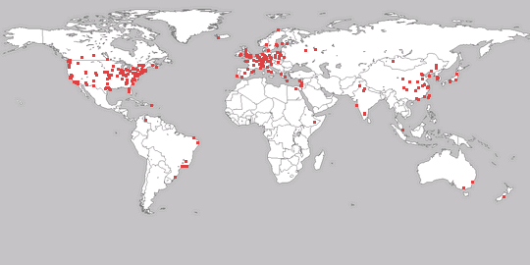
The Context: The Global Information Grid (GIG)
localhost - - [25/Nov/2006:12:37:43 -0800] "POST / HTTP/1.1" 200 224
localhost - - [25/Nov/2006:12:37:43 -0800] "POST / HTTP/1.1" 200 236
localhost - - [25/Nov/2006:12:37:48 -0800] "POST / HTTP/1.1" 200 224
localhost - - [25/Nov/2006:12:37:48 -0800] "POST / HTTP/1.1" 200 224
Dec 10 04:07:50 Updated: pam.x86_64 0.77-66.13
Dec 10 04:07:51 Updated: openssl.x86_64 0.9.7a-43.4
Dec 10 04:07:51 Updated: openldap.x86_64 2.2.13-4
Dec 10 04:07:52 Updated: wget.x86_64 1.10.2-0.40E
Dec 10 04:07:52 Updated: util-linux.x86_64 2.12a-16.EL4.12
----Configure File Security...
Configure c:\autoexec.bat.
Configure c:\boot.ini.
Configure c:\config.sys.
Configure c:\ntbootdd.sys.
Warning 2: The system cannot find the file specified.
Error setting security on c:\ntbootdd.sys.
?
Log files
  Apache, asl, access_log, crashreporter, interface.loop, windowserver_last.log, page_log, install.log, ...
Network packets
  DNS, TCP/IP, ...
Data from industrial partners
  telephone call detail, invoice records, transactions, financial detail ....
Global information and monitoring systems generate huge volumes of data in countless different formats.

Slide 7
Objectives
Long-term Goals
  To design and develop a toolkit that enables rapid (i.e.: real time) analysis, querying, visualization and transformation of any new data source
Current state-of-the-art
  Current manual practice is labor-intensive and error prone
  Requires writing parsers & query tools for every new file format encountered
  Generates specialized analysis and visualization tools tailored to that data format – infrastructure not reusable
Short-term Seedling Technical Challenge
  Automatically infer data formats from sample (ASCII) data
  Inferred data formats may be fed into PADS compiler infrastructure to generate new tools: data parser, printer, query engine, XML translator, statistical analysis, ...
This seedling studies the feasibility of inferring the format of previously unseen ASCII data.

Slide 8
System Overview
Input File(s)
Chunked
Data
Tokenization
Structure
Discovery
Format
Refinement
Scoring
Function
Data Description
The format inference procedure is accomplished in several steps named Tokenization, Structure Discovery & Format Refinement. A Scoring Function evaluates the results of the process and initiates a feedback loop.

Slide 9
“0, 24”
“foo, beg”
“bar, end”
“0, 56”
“baz, middle”
“0, 12”
“0, 33”
…
Simple example to show how format inference works.
Initial Input is a file or set of files

Slide 10
“0, 24”
“foo, beg”
“bar, end”
“0, 56”
“baz, middle”
“0, 12”
“0, 33”
…
“0, 24”
“foo, beg”
divide input
into “chunks”
“bar, end”
...
Note: Depending on the situation, either:
every line of a file forms a chunk, or
when you have many files, every file is a chunk.
Data files are first divided into “chunks” where each chunk is assumed to have similar structure.
Notes:
For now, a “chunk” is a line terminated by “\n”.

Slide 11
“0, 24”
“ INT , INT ”
“foo, beg”
“ STRING , STRING ”
“bar, end”
tokenize
“chunks”
“ STRING , STRING ”
...
...
Note: Tokens are either
defined by simple character classes:
  series of numbers = INT;
  series of alpha-numeric characters = STRING;
  each punctuation symbol has its own token type
defined by domain-specific regular expression:
  date
  time
  url
  etc.
Each chunk is divided into a list of tokens.
Notes:
My thoughts: We put too much in the tokenizer.

Slide 12
struct
“ INT , INT ”
“ STRING , STRING ”
“
union
,
union
”
“ STRING , STRING ”
structure
discovery
...
INT
STRING
STRING
STRING
Note: Structure Discovery infers a rough description from tokenized data. These rough descriptions are represented as an abstract syntax tree. The nodes in the tree have one of the following forms:
basic token (INT, STRING, “, etc)
struct – indicates its children appear in sequence in a chunk
union – indicate choices between its children
array – indicate a sequence of unknown length of its children (not shown in picture)
Note: At this point descriptions are quite similar to regular expressions (extended with complex basic tokens) – readers may ignore the differences.
The structure discovery infers a description much like a regular expression from tokenized data.

Slide 13
struct
struct
“
union
”
“
union
,
union
”
structure
refinement
struct
struct
INT
STRING
STRING
STRING
0
,
INT
STRING
,
STRING
Note: Structure refinement rewrites a rough description into a more accurate one by doing a value-space analysis on the original data using the rough structure as a guide. Example information inferred includes
invariant data fields (i.e: constant strings and ints)
dependent data fields
enumerations
integer ranges
array lengths (both constant and dependent on other parsed data)
switched unions (unions whose branch depends on earlier data)
generic rewriting steps that transform rough structure to make it more compact and/or precise
The structure refinement phase reanalyzes input data and rewrites descriptions to optimize precision and compactness.

Slide 14
struct
struct
35
“
union
”
“
union
27
”
struct
struct
scoring
struct
5
struct
12
0
,
INT
STRING
,
STRING
0
,
INT
3
4
,
4
STRING
STRING
Note: An information-theoretic scoring function evaluates the complexity of the description relative to the data described, giving a score to each node in the tree.
Note: The scoring function is designed to balance accuracy against compactness.
Note: At the moment this scoring function is an evaluation tool; in the future it will also be used to guide further structure discovery and refinement.
The scoring phase assigns a numeric value to every part of description, using information theory to balance accuracy and compactness of the description.

Slide 15
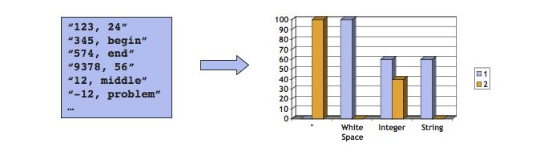
Structure discovery: finding clusters
Compute frequency distribution for each token
Cluster tokens for similar frequency distributions
  Quote and white space end up in the same cluster

Slide 16
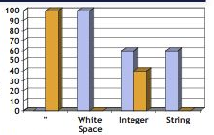
Structure Discovery: Finding Structs
Identify any “struct-like” cluster:
  Single-spike in frequency distribution
  Above threshold for coverage (number of chunks with all tokens in cluster).
“123, 24”
“345, begin”
“574, end”
“9378, 56”
“12, middle”
“-12, problem”
…
123
345
574
9378
12
-12
…
Struct{
“\””;
TBD_0;
“, “;
TBD_1;
“\””;
}
“123, 24”
“345, begin”
“574, end”
“9378, 56”
“12, middle”
“-12, problem”
…
24
begin
end
56
middle
problem
…
Recurse...

Slide 17
End-to-End Inference Real World Example:
207.136.97.49 - - [15/Oct/1997:18:46:51 -0700] "GET /turkey/amnty1.gif HTTP/1.0" 200 3013
207.136.97.49 - - [15/Oct/1997:18:46:51 -0700] "GET /turkey/clear.gif HTTP/1.0" 200 76
207.136.97.49 - - [15/Oct/1997:18:46:52 -0700] "GET /turkey/back.gif HTTP/1.0" 200 224
207.136.97.49 - - [15/Oct/1997:18:46:52 -0700] "GET /turkey/women.html HTTP/1.0" 200 17534
208.196.124.26 - - [15/Oct/1997:18:46:55 -0700] "GET /candatop.html HTTP/1.0" 200 10629
207.38.218.70 - - [16/Oct/1997:05:31:02 -0700] "GET /images/refhand4.gif HTTP/1.0" 200 6789
207.38.218.70 - - [16/Oct/1997:05:31:02 -0700] "GET /spanish/images/spespbut.gif HTTP/1.0" 200 427
pppch146141.dacom.co.kr - - [16/Oct/1997:05:31:09 -0700] "GET / HTTP/1.0" 200 3082
pppch146141.dacom.co.kr - - [16/Oct/1997:05:31:11 -0700] "GET /images/bsilk7.gif HTTP/1.0" 404 170
pppch146141.dacom.co.kr - - [16/Oct/1997:05:31:15 -0700] "GET /images/spot5.gif HTTP/1.0" 200 9372
pc21.ipc.univ-metz.fr - - [16/Oct/1997:05:48:28 -0700] "GET /amnesty/images/bsilk7.gif HTTP/1.0" 404 178
s4.usr1.ww-interlink.net - - [16/Oct/1997:05:48:31 -0700] "GET /amnesty/pakistan/viol.html HTTP/1.0" 200 7679
s4.usr1.ww-interlink.net - - [16/Oct/1997:05:48:34 -0700] "GET /amnesty/images/blkcnd2.gif HTTP/1.0" 200 1082
198.108.140.121 - - [16/Oct/1997:05:50:41 -0700] "GET /amnesty/usa/assault.html HTTP/1.0" 200 4292
198.108.140.121 - - [16/Oct/1997:05:50:42 -0700] "GET /amnesty/images/blkcnd2.gif HTTP/1.0" 200 1082
mso94.marsweb.com - - [16/Oct/1997:05:51:27 -0700] "GET /amnesty/death/cabana.html HTTP/1.0" 404 178
gk-red.unicc.org - - [16/Oct/1997:06:34:41 -0700] "GET /amnesty/mideast/mailbut2.gif HTTP/1.0" 200 1202
spg-tnt12s127.erols.com - - [16/Oct/1997:06:35:46 -0700] "GET /amnesty/urgact/index.html HTTP/1.0" 200 8283
spg-tnt12s127.erols.com - - [16/Oct/1997:06:35:48 -0700] "GET /amnesty/images/logo2.gif HTTP/1.0" 200 6343
131.123.15.27 - - [16/Oct/1997:06:35:54 -0700] "GET /images/aiusa2.gif HTTP/1.0" 200 2905
ppp31.igc.org - amnesty [16/Oct/1997:08:40:11 -0700] "GET /members/afreport.html HTTP/1.0" 200 450
tbm-jjs.caen.cnet.fr - - [16/Oct/1997:06:36:26 -0700] "GET /amnesty/death/cabana.html HTTP/1.0" 404 178
krafla.rhi.hi.is - - [16/Oct/1997:06:36:29 -0700] "GET /amnesty/images/aiusared.gif HTTP/1.0" 200 2725
1cust40.max6.santa-clara.ca.ms.uu.net - - [16/Oct/1997:02:08:04 -0700] "GET /asa/china/images/animai.gif HTTP/1.1" 200 5175
1cust40.max6.santa-clara.ca.ms.uu.net - - [16/Oct/1997:02:08:05 -0700] "GET /asa/china/images/smflag.gif HTTP/1.1" 200 951
ti18a37-0013.dialup.online.no - - [16/Oct/1997:02:08:44 -0700] "GET /amnesty/images/bsilk7.gif HTTP/1.0" 404 178
ww-to06.proxy.aol.com - - [16/Oct/1997:02:10:41 -0700] "GET / HTTP/1.0" 200 3082
ip160.ridgewood.nj.pub-ip.psi.net - - [15/Oct/1997:23:45:48 -0700] "GET /whatsnew.html** HTTP/1.0" 404 168
ip160.ridgewood.nj.pub-ip.psi.net - - [15/Oct/1997:23:46:10 -0700] "GET /whatsnew.html** HTTP/1.0" 404 168
Partial data from sample: Web Server Log “ai.3000”

Slide 18
Initially Discovered Structure
Pstruct(Id = BTy_37 3000)
Punion(Id = BTy_1 3000)
[IP] (Id = BTy_0 1704);
[Host] (Id = BTy_2 1296);
End Punion;
[White] (Id = BTy_3 3000);
[Other](-) (Id = BTy_4 3000);
[White] (Id = BTy_5 3000);
Punion(Id = BTy_7 3000)
[Other](-) (Id = BTy_6 2999);
[String] (Id = BTy_8 1);
End Punion;
[White] (Id = BTy_9 3000);
[Other]([) (Id = BTy_10 3000);
[Date] (Id = BTy_11 3000);
[Other](:) (Id = BTy_12 3000);
[Time] (Id = BTy_13 3000);
[Other](]) (Id = BTy_14 3000);
[White] (Id = BTy_16 3000);
[Other](\") (Id = BTy_17 3000);
[String] (Id = BTy_18 3000);
[White] (Id = BTy_19 3000);
[Path] (Id = BTy_20 3000);
(continued on right column)
Punion(Id = BTy_22 3000)
[Empty] (Id = BTy_21 2998);
Pstruct(Id = BTy_28 2)
[Other](*) (Id = BTy_23 2);
[Other](*) (Id = BTy_24 2);
[White] (Id = BTy_25 2);
[String] (Id = BTy_26 2);
[Path] (Id = BTy_27 2);
End Pstruct;
End Punion;
[Other](\") (Id = BTy_29 3000);
[White] (Id = BTy_31 3000);
[Pint] (Id = BTy_32 3000);
[White] (Id = BTy_33 3000);
Punion(Id = BTy_35 3000)
[Pint] (Id = BTy_34 2651);
[Other](-) (Id = BTy_36 349);
End Punion;
End Pstruct
type comp = 187.4
atomic comp = 1246.8
data comp = 3,722,785.5
total comp = 3,722,972.9
Result of the initial structure discovery phase for ai.3000 with complexity scores

Slide 19
Refined Structure
Pstruct(Id = BTy_37 3000)
Punion(Id = BTy_1 3000)
[IP] (Id = BTy_0 1704);
[Host] (Id = BTy_2 1296);
End Punion;
[StringConst] " - " (Id = BTy_3 3000) (avg: 3.00, tot: 9000);
Punion(Id = BTy_7 3000)
[StringConst] "-" (Id = BTy_6 2999) (avg: 1.00, tot: 2999);
[StringConst] "amnesty" (Id = BTy_8 1) (avg: 7.00, tot: 7);
End Punion;
[StringConst] " [" (Id = BTy_9 3000) (avg: 2.00, tot: 6000);
[Enum] {[StringConst] "15/Oct/1997", [StringConst] "16/Oct/1997", } (3000) (avg: 11.00, tot: 33000);
[StringConst] ":" (Id = BTy_12 3000) (avg: 1.00, tot: 3000);
[Time] (Id = BTy_13 3000);
[StringConst] "] \"" (Id = BTy_14 3000) (avg: 4.00, tot: 12000);
[Enum] {[StringConst] "GET", [StringConst] "POST", } (Id = BTy_18 3000) (avg: 3.00, tot: 9001);
[StringConst] " " (Id = BTy_19 3000) (avg: 1.00, tot: 3000);
[Path] (Id = BTy_20 3000);
Poption(Id = BTy_22 3000)
[StringConst] "** HTTP/1.0" (Id = BTy_23 2) (avg: 11.00, tot: 22);
End Poption;
[StringConst] "\" " (Id = BTy_29 3000) (avg: 3.00, tot: 9000);
[Int] [200...404] (Id = BTy_32 3000) (avg: 6.00, tot: 18000);
[StringConst] " " (Id = BTy_33 3000) (avg: 1.00, tot: 3000);
Punion(Id = BTy_35 3000)
[Int] [35...37947] (Id = BTy_34 2651) (avg: 7.53, tot: 19954);
[StringConst] "-" (Id = BTy_36 349) (avg: 1.00, tot: 349);
End Punion;
End Pstruct
new type comp = 568.0
new atomic comp = 861.8
new data comp = 2,570,258.3
new total comp = 2570826.3
Final result of the structure refinement phase for ai.3000 with complexity scores

Slide 20
Criteria for a good scoring function
Finding a function to evaluate the “goodness” of a description involves balancing two ideas:
  a description must be concise
    people cannot read and understand enormous descriptions
  a description must be precise
    imprecise descriptions do not give us much useful information
Note the trade-off:
  increasing precision (good) usually increases description size (bad)
  decreasing description size (good) usually decreases precision (bad)
An effective scoring function rewards both precision and brevity in a description.

Slide 21
Minimum Description Length (MDL) Principle
Minimum Description Length (MDL) Principle:
  Good descriptions are those that minimize the sum of the bits required to transmit the description (T) + the bits required to transmit the data relative to the description (D given T)
  Mathematically, we aim to find the minimum transmission cost:
  This idea has been used in machine learning & comes from information theory.
Note the trade-off:
  increasing precision decreases Bits-For-Data(D given T) but increases description size Bits-For-Description(T)
  decreasing description size decreases Bits-For-Description(T) but usually decreases precision, increasing the transmission cost of the data (i.e.: Bits-For-Data(D given T))
Transmission Bits = Bits-For-Description(T) + Bits-For-Data(D given T)
Minimizing the sum of bits for transmitting description T + bits for transmitting data D given description T rewards both precision and brevity in a description as desired.

Slide 22
Complexity of Pstring
str = [A-Za-z][A-Za-z0-9_\-]*;
0-9
A-Z
A-Z
a-z
a-z
_\-
52
∗
64^{n}
type complexity is log₂ numConstructors = 4.907
atomic complexity is log₂ numStringChars * average token length
data complexity is log₂ numStringChars * sum token lengths
comments:
  Ignored the special case of the first character in this computation
C = log₂ numConstructors = 4.907
S = log₂ numStringChars = 6

Slide 23
Complexity of StringConst
StringConst “abcdefgh”
  type complexity is C + length * S = 4.907 + 8 * 6 = 52.907
  atomic complexity is 0
  data complexity is 0
C = log₂ numConstructors = 4.907
S = log₂ numStringChars = 6

Slide 24
Complexity of Punion
Base (Pstring _x0005_“HIGH THEIR”)
?
Base (Pint 2)
100
10 * log₂ 64 = 60.0
type
log₂ 2 = 1
900
1 + log₂ 10 = 4.322
atomic
log₂ 2 = 1
(1/10) * 10 * log₂ 64 + (900/1000) * 1 * log₂ 10
data
log₂ 2 = 1
100 * log₂ 64 + 900 * 1 * log₂ 10
Example: Punion (Base (Pstring _x0005_“HIGH THEIR”)) (Base (Pint 2))
  type complexity: C = 4.907 + log₂ 2 + 10 * log₂ 64 + 1 * log₂ 10 = 4.907 + 1 + 60 + 3.322 = 69.229
  atomic complexity: log₂ 2 + 0.1 * 10 * log₂ 64 + 0.9 * log₂ 10 = 1 + 6 + 0.9 * 3.322
  Data complexity: log₂ 2 + 100 * log₂ 64 + 900 * log₂ 10 = 1 + 600 + 900 * 3.322
Assumptions for the example:
  All strings of equal length
  All integers only one digit
C = log₂ numConstructors = 4.907
S = log₂ numStringChars = 6

Slide 25
A word on measurement
"Far better an approximate answer to the right question, which is often vague, than the exact answer to the wrong question, which can always be made precise." J. W. Tukey (1962)
“The combination of some data and an aching desire for an answer does not ensure that a reasonable answer can be extracted from a given body of data." J. W. Tukey (1986)

Slide 26
Remaining Questions (Post-seedling)
Structure Discovery
  how do we deal with sophisticated formats involving multiple different sorts of “chunks”?
  how do we incorporate and manage feedback from the scoring function?
  how do we deal with recursive formats?
  how do we manage user input or inference in the presence of partial outside format information?
  what user input is useful or desirable?
  what can we prove about structure discovery (completeness under what theoretical models?)
Structure Refinement
  how do we incorporate and manage feedback from the scoring function?
  how do we manage user input or inference in the presence of partial outside format information?
  what user input is useful or desirable?
  how do we engineer a generic and extensible rewriting framework?
  what can we prove about structure discovery?
    are the rules semantics-preserving relative to the data? (i.e.: correct?)
    are rewriting rules confluent (i.e. order-independent?)
    can we design rules that are eventually quiescent?
    are the rules optimal or complete? under what theoretical models?
    are they guaranteed to improve information-theoretic complexity?
How do we visualize the results?
How do we pipe inference results into downstream data management tools?
How do we incorporate binary data into the process?
And many, many more ...
Our inference engine has already been successful on simple formats, but many questions, both theoretical and practical, remain.

Slide 27
Quiz
Something you should know but probably don’t

Slide 28
Who invented the bit?
But he did not call it a “bit”

Slide 29
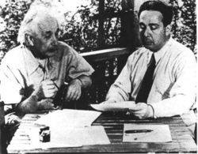
It was one of these guys:

Slide 30
It was one of these guys:
Albert Einstein
Leo Szilard

Slide 31
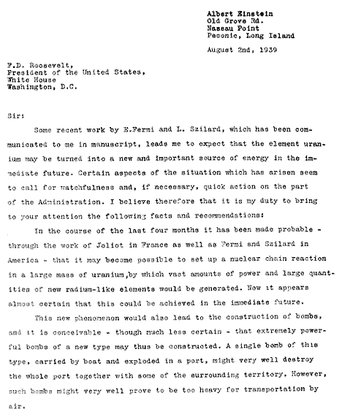
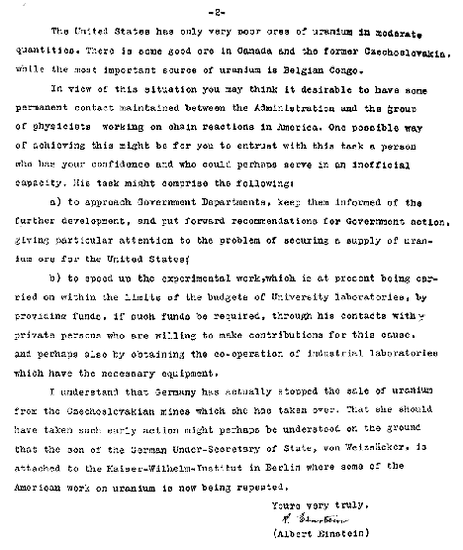
Leo Szilard is best known for this

Slide 32
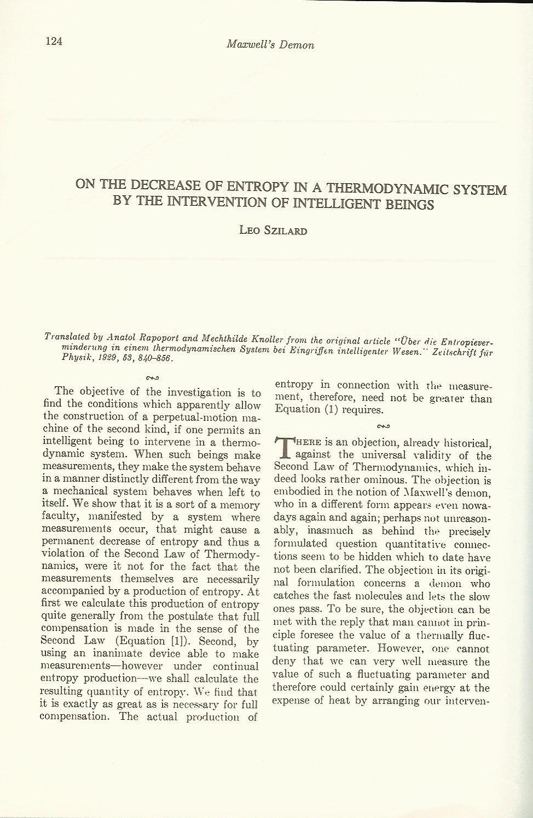
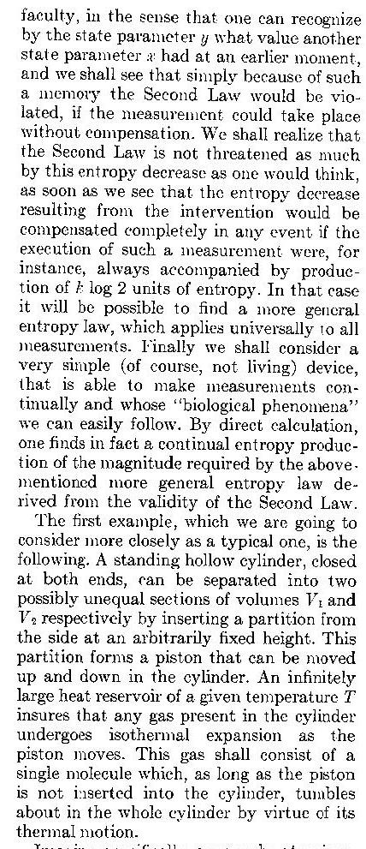
But not as well known for this:

